Slide 1
CROWDFUNDING PLATFORM USING META MASK WALLET(ETHEREUM)
Team Members
R. Venkata Keerthi (19KD1A05E6)
V. Shyamal Deepak (19KD1A05I8)
Ch. Bhavani (20KD5A0503)
Ch. Naveena (20KD5A0504)
Mentor
M.Sriramulu,
M.Tech,Assistant Professor,
Dept.of CSE.

Slide 2
INDEX
Introduction
Abstract
Literature Survey
Existing System and Limitations
Proposed System and Advantages
Algorithm
Design
System Requirements
Conclusion

Slide 3
INTRODUCTION
Crowdfunding has become a popular method for individuals, startups, and businesses to raise funds for their projects or ideas. With the rise of blockchain technology, it has become even easier to create a decentralized crowdfunding platform that is transparent, secure, and accessible to anyone with an internet connection
This project aims to create a crowdfunding platform using the MetaMask wallet on the Ethereum blockchain. The platform will allow users to create campaigns, set funding goals, and accept donations in Ether (ETH). The platform will also have features such as campaign updates, rewards for donors, and a dashboard for campaign creators to track their progress.
To develop this platform, we will use Ethereum smart contracts to manage the transactions and funding goals. We will also use web3.js and other web technologies to create a user-friendly interface that integrates seamlessly with MetaMask.
Overall, this crowdfunding platform using MetaMask wallet will provide an easy, secure, and transparent way for individuals to fund their projects and for contributors to support the projects they care about.

Slide 4
ABSTRACT
The advent of cryptocurrencies has revolutionized the way we approach fundraising and investment. Blockchain technology, in particular, provides an ideal platform for crowdfunding, as it offers transparency, security, and decentralization. It also allows individuals or organizations to raise funds for a particular project or cause by soliciting small contributions from a large number of people. In our project, we would leverage the power of decentralized technologies such as blockchain and smart contracts to create a more transparent, secure, and efficient platform for raising and managing funds. It would allow creators to connect directly with their supporters and also provide a way for backers to track the progress of the projects they support. The main aim is to create a full-fledged web 3.0 application that allows users to send transactions through the blockchain. Each transaction will belong to a specific crowdfunding campaign and it will be forever stored on the blockchain. For this, we make use of the third web which is a web3 development framework and reactJS.

Slide 5
LITERATURE SURVEY
Crowdfunding using Ethereum Blockchain :
The rise of Blockchain technology enables us to create secure, trusted and decentralized apps. Crowdfunding is an online money raising strategy that uses small amounts of capital from a large number of individuals which finance a new business project.
Link : https://www.ijraset.com/research-paper/crowdfunding-using-ethereum-blockchain#introduction
Crowdfunding Platform Using Blockchain Technology :
Crowdfunding is a type of internet fundraising that developed as a method for people to donate a small amount of money to help inventive people support a business or raise funds for medical emergencies.
Link : https://ijirt.org/master/publishedpaper/IJIRT155716_PAPER.pdf

Slide 6
EXISTING SYSTEM
Crowdfunding is an online money-raising strategy that began as a way for the public to donate small amounts of money to help creative people finance their projects. Through crowdfunding, individuals are able to invest in entrepreneurial start-ups using an intermediary agency like a broker or dealer.
The problem with the current sites is that they don’t provide a donor guarantee policy and they do not have control over the money they donated. Our Trusted Crowdfunding Platform is a solution to these issues of the previous system. It uses smart contract technology to develop a trusted Crowdfunding platform
LIMITATIONS
You May Not Reach Your Funding Goal & May Need to Offer Rewards
You Will Need to Spend Time Promoting Your Campaign
There is No Guarantee of Success
You May Not Be Ready for the Responsibilities

Slide 7
PROPOSED SYSTEM
In our proposed system we are providing the This system is aimed to overcome the above major shortcomings with current crowdfunding platforms .Crowd fundraising involves a large number of transactions, it is necessary to manage and document them legally.
As a result, a smart contract is utilized, which is a transaction protocol that automatically executes, controls, and documents transactions on behalf of project creators and investors in accordance with the agreement.
ADAVANTAGES
It offers a simple user interface & it’s a free-to-use wallet.
It is available on mobile devices as well as a browser extension.
It includes integrated exchanges in order to make easy trading.
No need to create separate login credentials.
It is quick as well as easy access to an individual’s finds on Ethereum

Slide 8
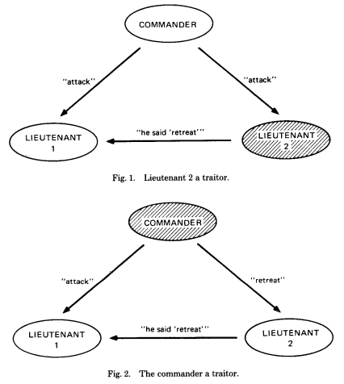
ALGORITHM
BYZANTINE FAULT TOLERANCE :
Byzantine Fault Tolerance is a type of feature for the distributed
networking system by which we can recover the networks
when some nodes are not able to respond the incorrect information.
The main objective of Byzantine Fault Tolerance is to provide
a safeguard against the failure of the system. It has another
aim to reduce the faulty node. This problem was first
derived from the Byzantine General problem.

Slide 9
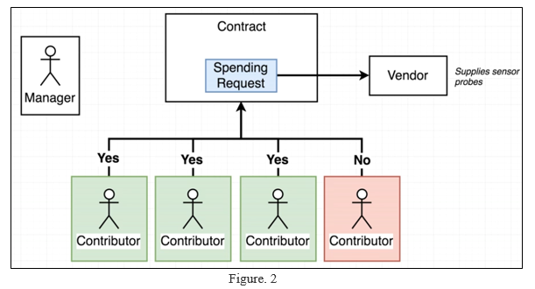
SYSTEM ARCHITECTURE

Slide 10
In the above architecture, All the contract code are written in solidity that is used to deploy a contract in blockchain platform. The Campaign Factory is built and used to deploy the contract in the network. With the help of campaign factory, the new campaigns can be created. Whenever a campaign factory is deployed a very small amount of gas fee is needed. The creator or manager of the project will request money for buying some accessories related to that project. He will then create a request with the help of the request form. This form will be recorded and stored in the blockchain. If necessary, all the contributors need to approve the request. If not then they can reject the request. Once the voting is done then the request will be finalized and to finalize the request the number of approvers count must greater than half the total number of approvers that have contributed in the campaign. If it meets the requirements,

Slide 11
SYSTEM REQUIREMENTS
SOFTWARE REQUIREMENTS
Operating System : Windows 7 or later
Technologies : Blockchain
Programming Languages : Solidity,React.js
Tools : Ethereum,Metamask,Node.js
HARDWARE REQUIREMENTS
RAM : 4 GB(min)
Hard Disk : 05+ GB
Processor : Intel core i3 or later

Slide 12
CONCLUSION
In this piece of work, we endeavored to leverage the existing crowd funding methods of raising funds to more secure, transparent and verifiable way. We were also successful in achieving this with the help of Ethereum network. The security issues in crowdfunding platforms can be answered by the introduction of the blockchain technology which functions on a trust-free system. With the help of Ethereum network the money doesn’t go directly in the hands of the campaign initiator, whereas it is been stored on an Ethereum account.

Slide 13
THANK YOU

